Slide 1
Michigan DOT
Roadside Safety and Real-time Data
Michael Doenges
Smart and Connected Transportation
Consulting Systems Engineer

Slide 2

Real-time data decision making
Increasing Safety
and Visibility

Slide 3


Defining Digital Roadway Architecture
Flexible and embedded intuitive network
Differentiated controls based on business and security requirements
Enhanced security & resiliency
Applied intelligence within defined tiers
Dynamic and Sustainable Systems
Digitized existing decision process
Actionable roadmap for implementation

Slide 4





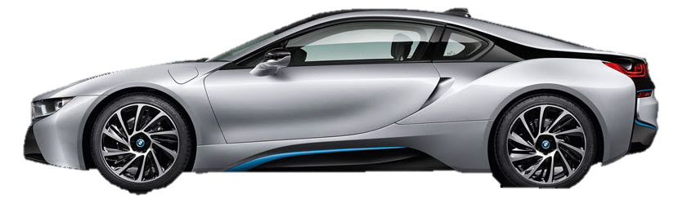
Infrastructure and Software Enable End-to-End V2X Architecture for CAV
End-To-End Security
and Flow of Data
Enabled by applications & solutions
Autonomous Vehicles
V2X
OEM OTA Services
Fleet
Management
Central Security Systems
Data Broker Platform
Public Sector RSU
& Traffic Management
Center
Automotive Cloud
OTA, OEM
Integration
Service Provider
Cloud
Connected to everything…
...everywhere
V2X Gateway
IVI Gateway
Secure, streamlined, agile vehicle

Slide 5
What makes mobility “smart” ?
Improved Performance and Customer Experience
Always Updating
Operations Focused
Faster data transfers and data pervasiveness across IoT
Availability of fiber in ROW
New sensors and DSRC
Low-power, battery-operated options for device connectivity
Edge and cloud computing
Enhanced system operations that includes vehicle and data from the vehicle
Data collection and storage for near-real time and predictive applications
Local, first-level processing before transferring data from the device
Actionable intelligence from connected devices
Integration with CAV
Corridor and emergency management
Maintenance and asset management

Slide 6

Steps to Success
Infrastructure | Data | Applications
Provide WAN backhaul and secure sensors
Collect and normalize sensor data
Improve safety, mobility, and environmental performance

Slide 7
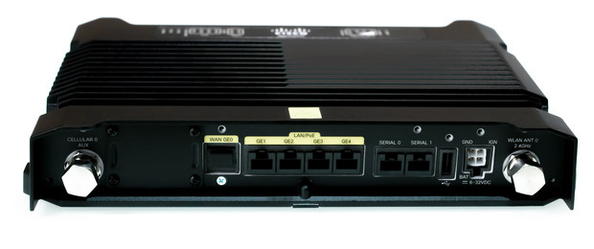
Connected Roadways Foundation
Infrastructure
Provide WAN backhaul and secure sensors
MPLS-enabled backhaul communications to enable resiliency, data segmentation, and security of sensors, traffic lights, and CAVs
Integrated security architecture based on NIST framework for threat detection, identity management, and network segmentation firewalls
Distributed compute and central data storage
Service access points and industrialized Ethernet
DSRC gateways
Application security
Cisco Industrial Mobile Router

Slide 8

Cisco Kinetic:
- Smart+Connected™ Digital Platform
- Edge and Fog Fabric
 | Data
Collect and normalize sensor and DSRC data
Automated data distribution
Real-time dashboard
Single data presentation layer
Data lake
“CV and ITS deployments should be aligned with agency performance standards and holistic data requirements so that DOTs can leverage data sources across the organization.” USDOT JPO

Slide 9
Applications Based on Agency Goals
 |  | Applications
Smart Mobility
Real-time operations for: variable speed, traffic re-routing, emergency response, collision avoidance, road-weather, and work zone safety and awareness.
Planning and asset management applications including predictive analytics, traveler information, logistics and freight
Improve safety, mobility, and environmental performance and manage system

Slide 10
Initial Approach
Discover
Analyze
Report
Review drivers for segmentation with stakeholders
Gain insight into current state of environment
Facilitate discussions to broaden perspective of future state
Review workshop findings and overall approach
Develop POC vision that meets current and future needs
Identify key strategic objectives to move toward future state
Summarize customer’s current state and workshop findings
Provide future state vision and tie to broader business goals
Recommend key strategic objectives to move toward future state

Slide 11
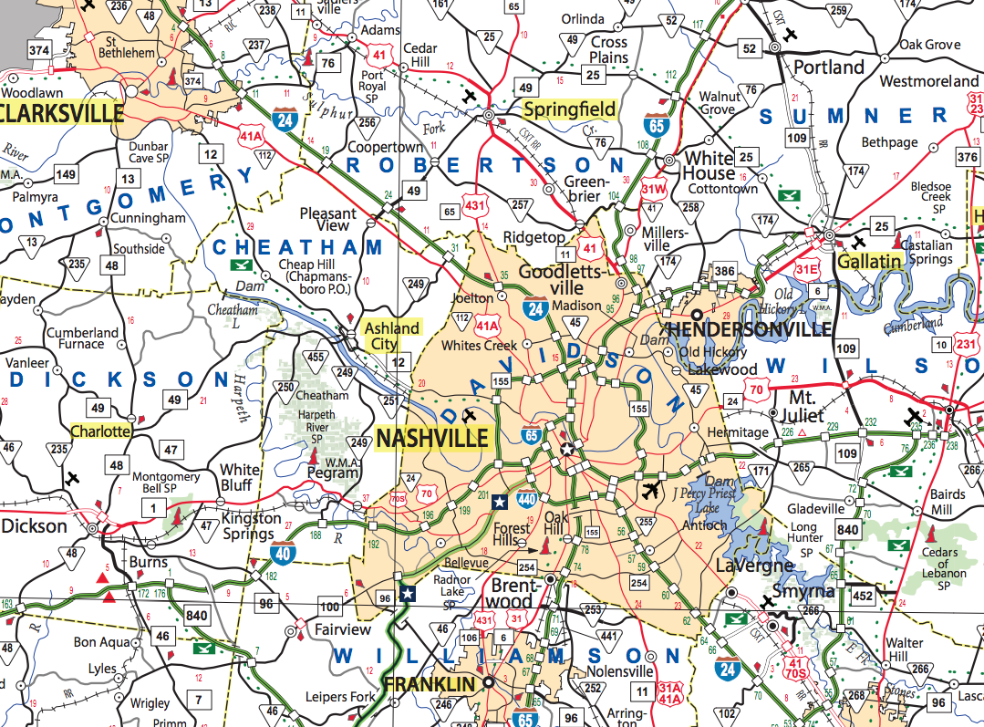
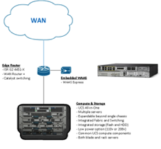
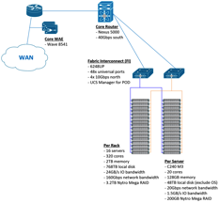
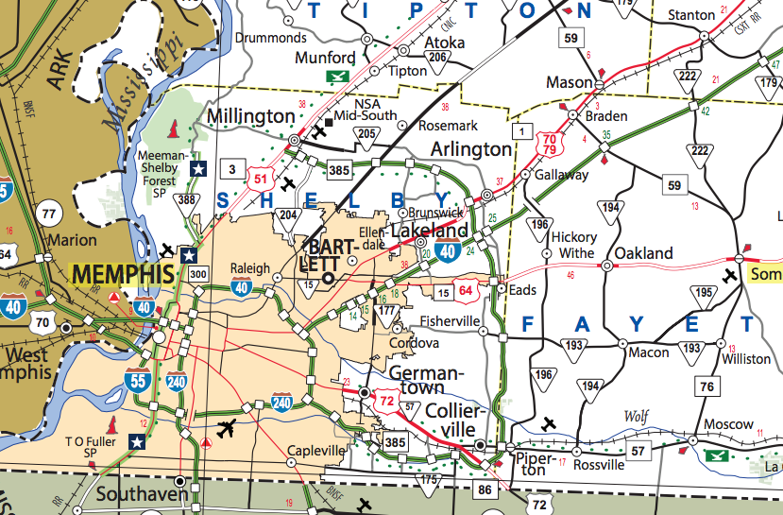
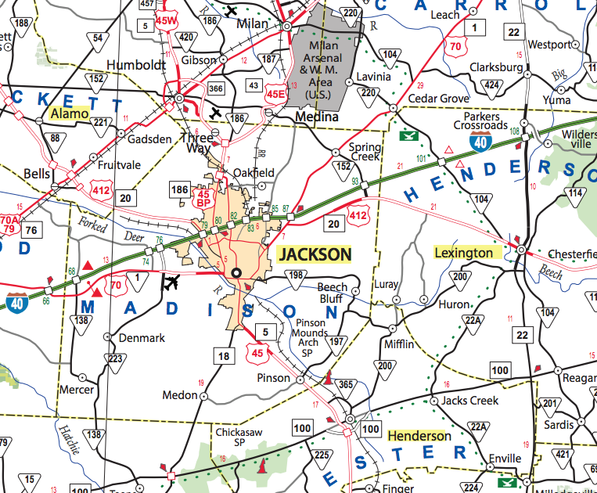
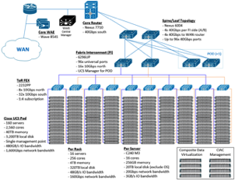
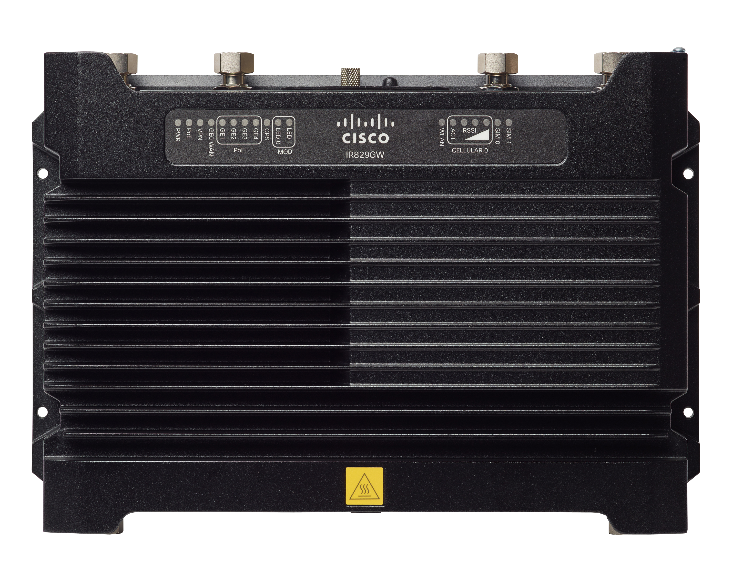
Focus Areas
Roadway Monitoring, Maintenance & Safety Automation
Roadside & Vehicles
Sensors
Devices
Edge Analytics
Hub Areas
Fog Node
Real-Time Dashboards
Alerting
TMC
Fog Aggregation Nodes
Roadway History & Trends
Reports & Dashboards
Operational Cloud
HPC & DV
Data Mining & Modeling
Inter-Cloud Data Lake

Slide 12
Connected Roadway Sites
We are targeting the following locations:
I-96/I-696 Interchange
I-94 Roadway Weather Site
Stationary Work Zone
Mobile Work Zone

Slide 13
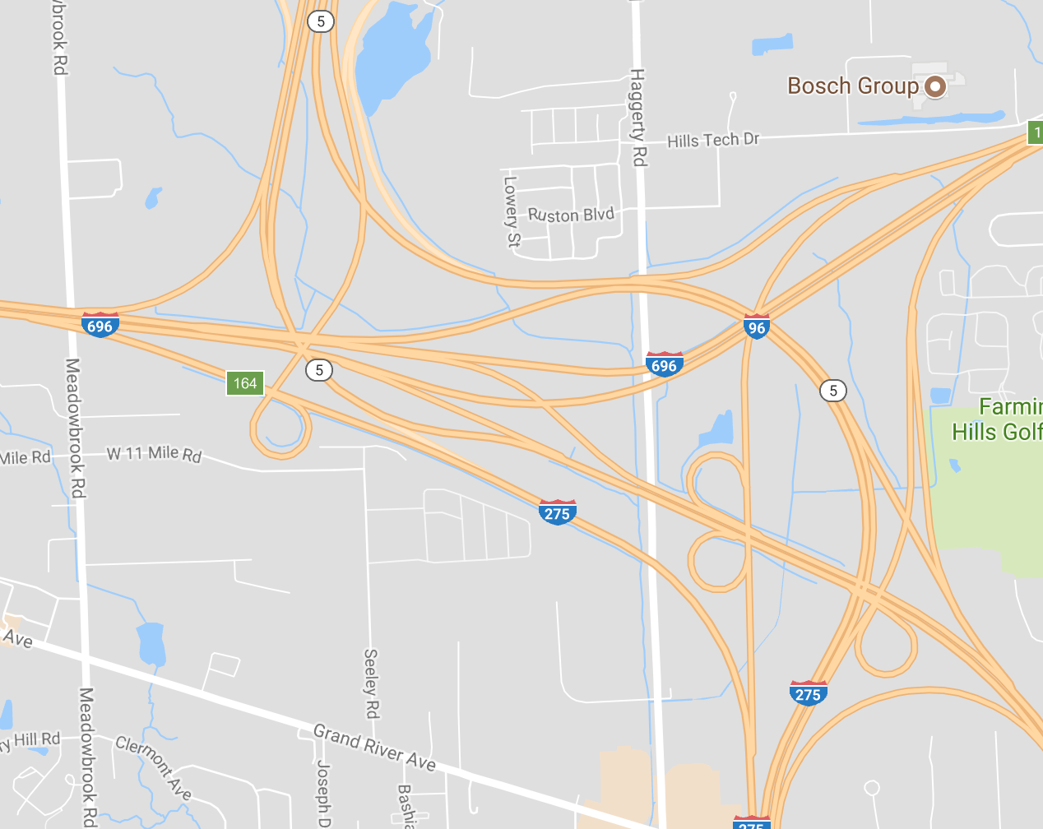
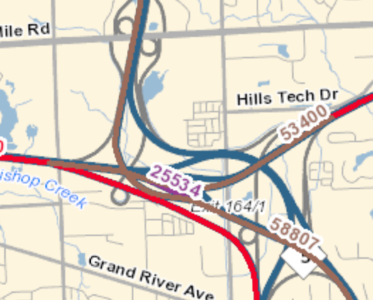
1. Interchange I-96 -> I-696
Roadway Safety – Real-time Data
Monitor for Slow or Stopped Traffic
Use DSRC Data Points to enrich traffic data and collision/near miss info.
Integrate real-time or near real-time driver communication
Provide real-time status to TMC with appropriate data visualization and reaction workflows (DMS/VMS approvals)
Additional Use cases
  Wrong Way
  Vehicle Counts and Classification
https://mdotnetpublic.state.mi.us/tmispublic/definitions.aspx

Slide 14
2. I-94
Roadway Weather – Roadway Interaction
Gather Weather Data RWIS & DSRC
Translate data to relevant information for travelers
Leverage DMS and DSRC Messaging to relay weather related safety information to drivers and vehicles
Provide real-time status to TMC
Potentially integrate real-time “Floating Car Data” as an output to appropriate applications
Visualize data in TMC Operations

Slide 15
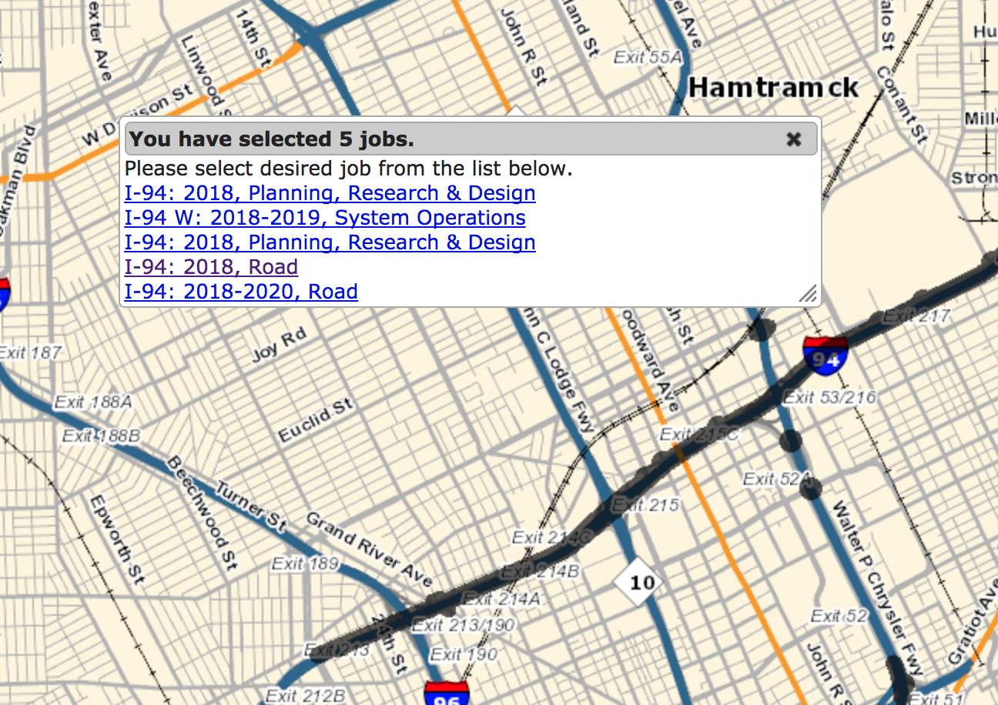
3. Stationary Work Zone
Site and Worker Safety – Digital Awareness
Gather site data using edge compute technologies and allow for data driven decision making
Monitoring and insights for construction safety planning
Real-time roadway monitoring for construction zone and worker safety
Alert interaction in an “Imminent Danger” situation
Leverage multiple sensors to gather vehicle speeds and interact with roadside and vehicle messaging to decrease speed and improve work zone safety
http://www.michigan.gov/msp/0,4643,7-123-72297_64773_41646---,00.html

Slide 16
4. Mobile Work Zone
Site and Worker Safety – Digital Awareness
Similar to Stationary Work Zone:
Attenuator Mounted System
Gather site data using edge compute technologies and allow for data driven decision making
Real-time roadway monitoring for construction zone and worker safety
Alert interaction in an “Imminent Danger” situation
Leverage multiple sensors to gather vehicle speeds and interact with roadside and vehicle messaging to decrease speed and improve work zone safety

Slide 17
Location Components
Interchange | Stationary WZ | Mobile WZ
Edge Computing - CGR1240
CGR Edge Compute Module
CGR LTE Connectivity Module
Cisco Kinetic Fog Computing
Cisco Kinetic Digital Platform Ops Center
Quantergy Lidar
Roadside Camera
Cohda DSRC RSU gateway
DSLink’s for specified components
Customized Micro Service for Traffic Monitoring and Safety
Edge Computing - CGR1240
CGR Edge Compute Module
CGR LTE Connectivity Module
Cisco Kinetic Fog Computing
Cisco Kinetic Digital Platform Ops Center
Quantergy Lidar
Roadside Camera
Cohda DSRC RSU gateway
DSLink’s for specified components
Customized Micro Service for Weather & Road condition monitoring and vehicle Feedback
Edge Computing - CGR1240
CGR Edge Compute Module
CGR LTE Connectivity Module
Cisco Kinetic Fog Computing
Cisco Kinetic Digital Platform Ops Center
Quantergy Lidar
Roadside Camera
Cohda DSRC RSU gateway
DSLink’s for specified components
Customized Micro Service for specified application
Mobile: DSRC OBU
Mobile: IR829

Slide 18
Needs from MDOT
Interchange | Stationary WZ | Stationary and Mobile WZ
Fiber or Cellular VPN/APN backhaul communications to enable resiliency, data segmentation, and security
Mounting location including power and clear line of site to roadway
Mounting and Connection services (crew assistance)
ITS & Ops, Integration Assistance
Roadside DMS/VMS
Roadside VSL
RWIS Location and Hardware
Fiber or Cellular VPN/APN backhaul communications to enable resiliency, data segmentation, and security
Mounting location including power and clear line of site to roadway
Mounting and Connection services (crew assistance)
ITS & Ops, Integration Assistance
Roadside DMS/VMS
Roadside VSL
Viable Construction Zone
Fiber or Cellular VPN/APN backhaul communications to enable resiliency, data segmentation, and security
Mounting location including power and clear line of site to roadway
Mounting and Connection services (crew assistance)
ITS & Ops, Integration Assistance
Roadside DMS/VMS
Roadside VSL
Mobile: Attenuator vehicle for mounting and connectivity. OBU/OBDII/CAN-BUS

Slide 19
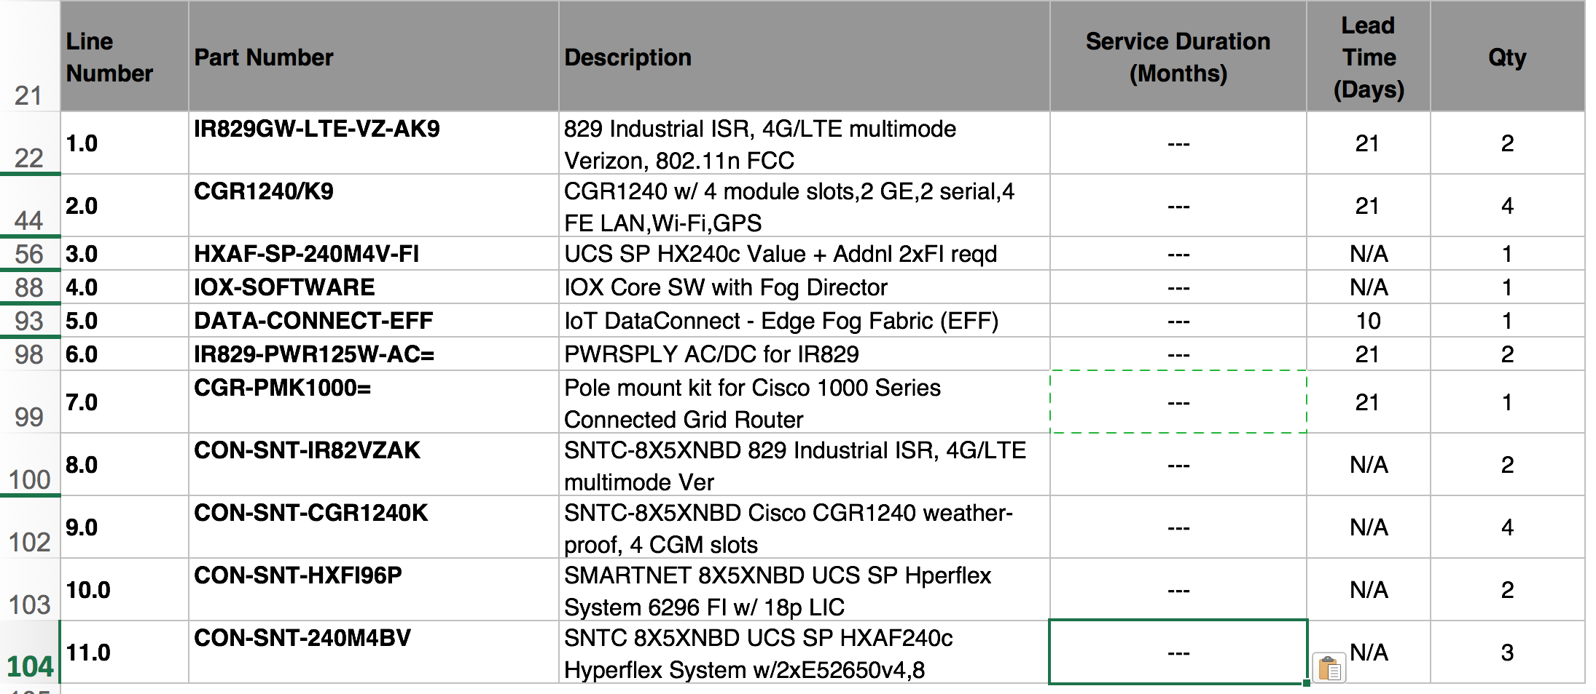
Site Components-

Slide 20
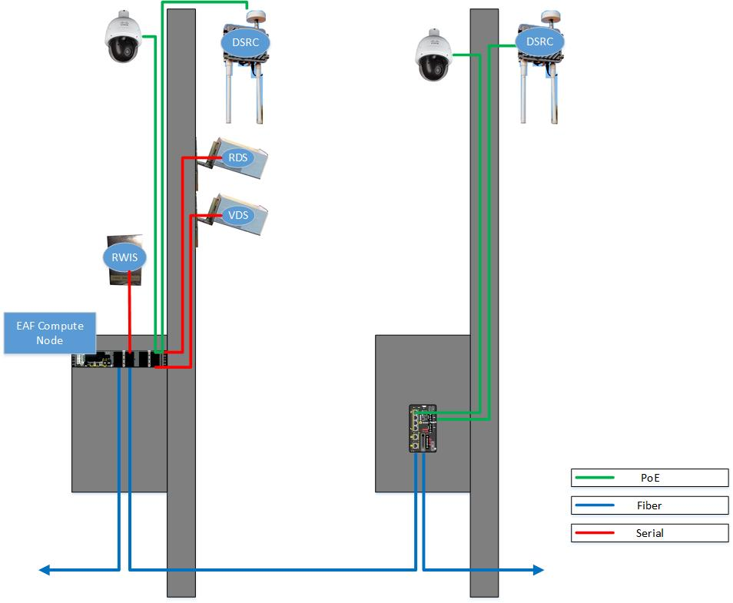
Site Components-
Lidar & Camera
Lidar & Camera

Slide 21
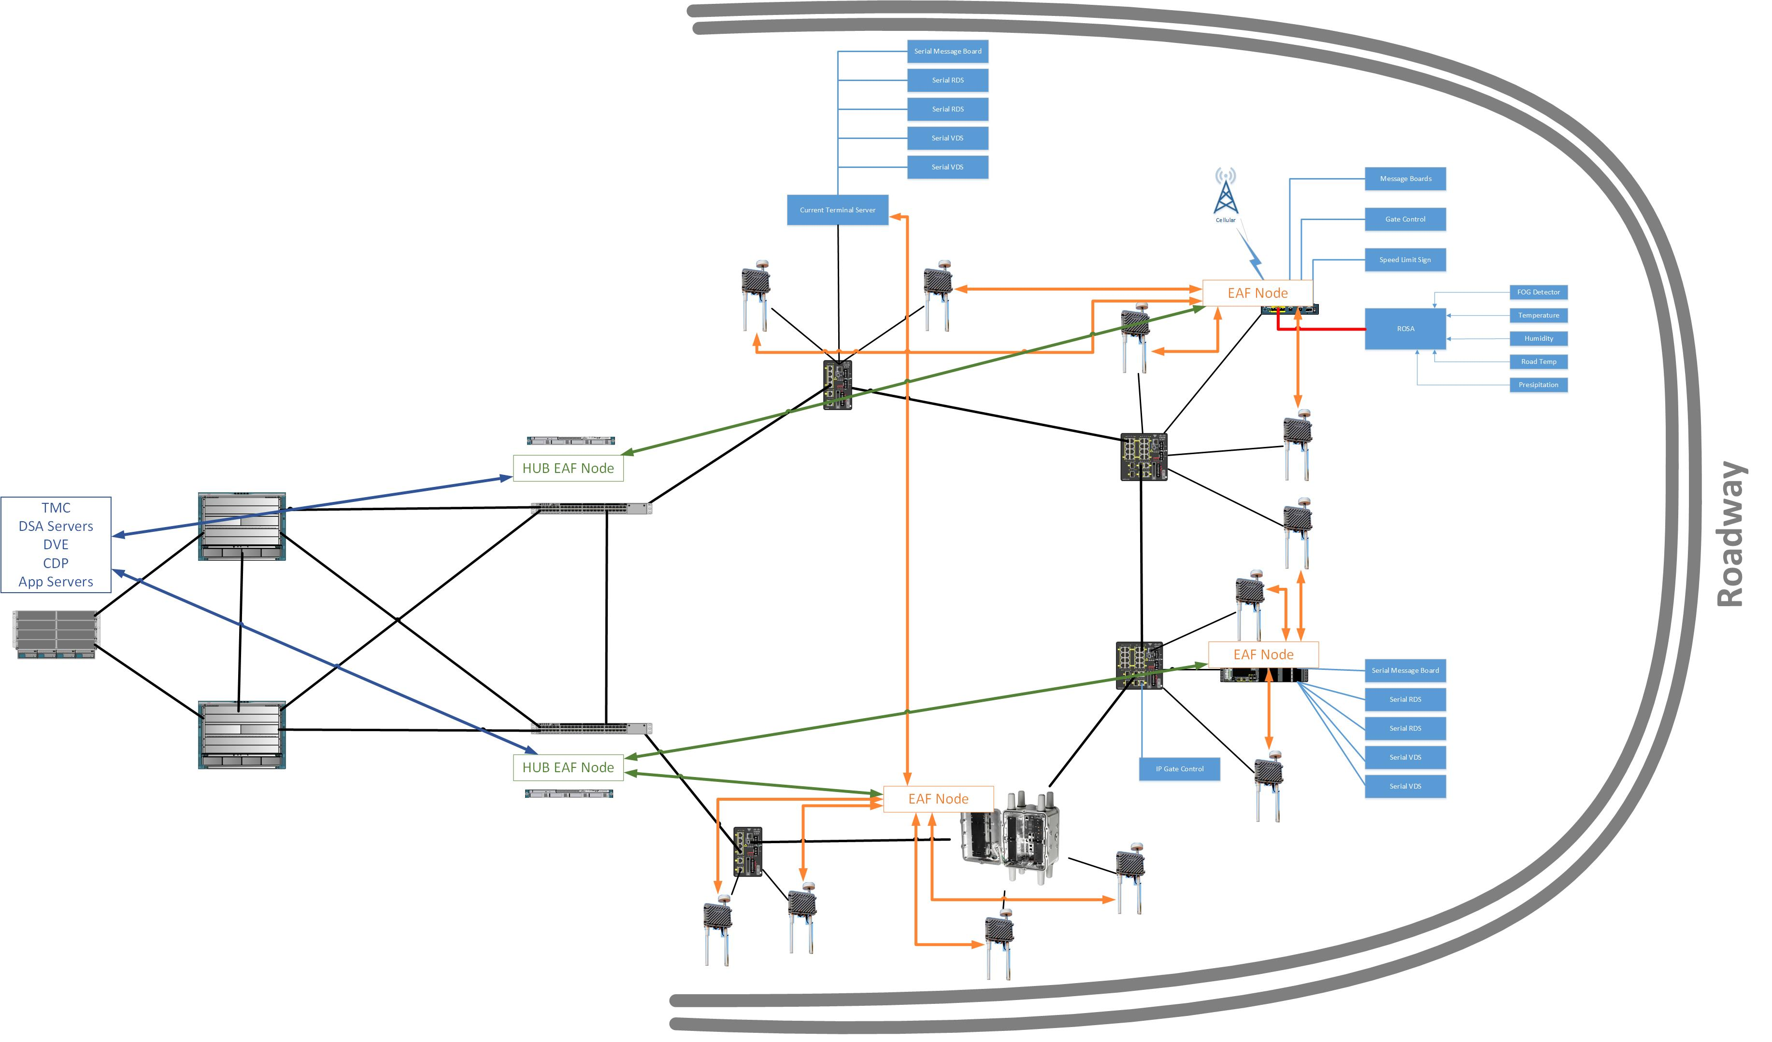
Site Components-

Slide 22
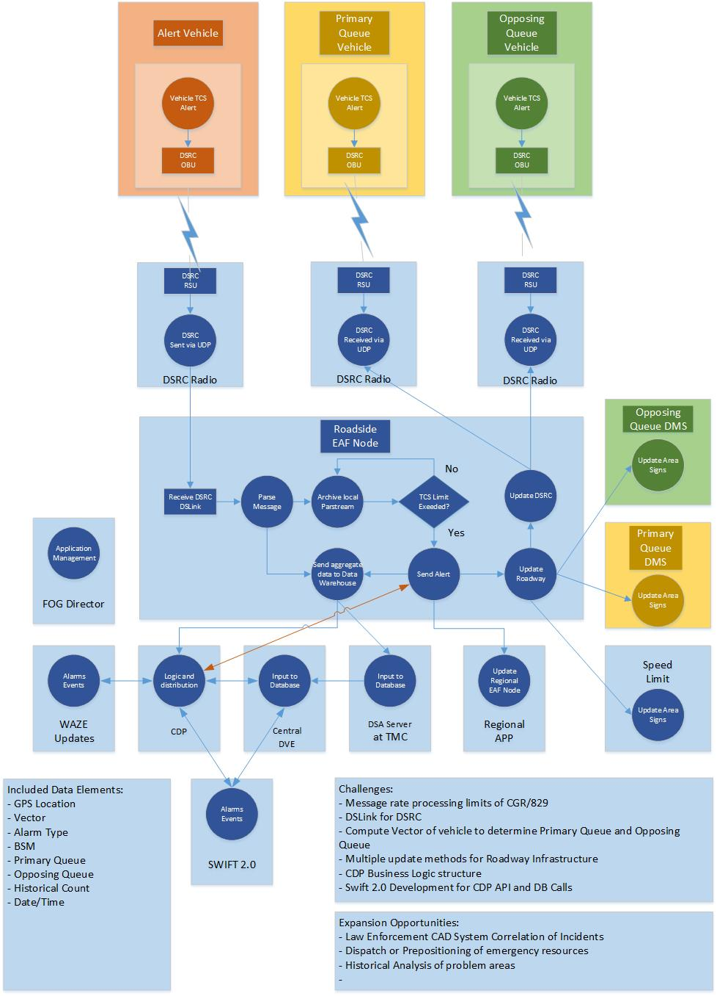
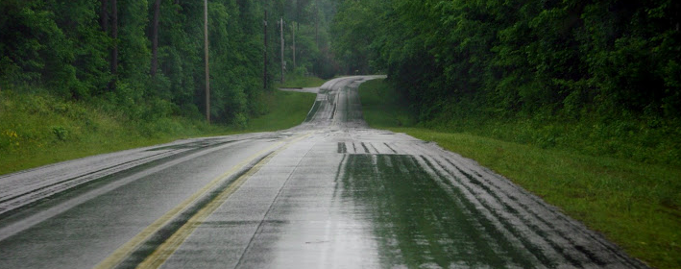
Traction Control Intelligence

Slide 23

Next Steps -
Physical Locations, Strategy and Architecture Review
Deep Dive Workshop
AS System Design
Micro service Workflow
Policy Translation
Data Structure
Security Controls
Execution and Implementation

Slide 24
Notes:
http://www.michigan.gov/documents/MDOT_ITS_Strategic_Plan_145436_7.pdf

Slide 25
Notes:
http://www.michigan.gov/documents/MDOT_ITS_Strategic_Plan_145436_7.pdf

Slide 26


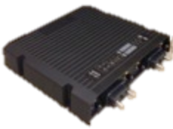


Connected Roadway Architecture
Traffic Management
Toll Administration
Fleet and Freight Management
Maintenance and Construction Management
Connected Car Ecosystem Applications
Cisco Kinetic
Composite APIs
SXP (ID Management, Data Brokerage and B2B Transactional Services)
Subscriber Engine
Device Engine
Data and Analytics Engine
Location Engine
CDP
Tunnel Provisioning Service
Gateway Management (FND)
Application Management (FD)
Network Management
IoT Data Connect Cloud Data Pipeline
IOT DC
End-to-End Security
MQTT/AMQP/HTTPs
3G/LTE
Network
IEEE 802.11P/ ITS-G5 (DSRC)
IW3700
Yard Wi-Fi
Network
IP/MPLS Network
IOT Data Connect Cloud Data Pipeline
MQTT/AMQP/HTTPS
IOT Gateway, Switch, Ruggedized Server
Device Connector
Application Connector
Cisco Kinetic (EFF)
Connect, Filter and Evaluate
Store Time/Series Data, Data Transform
Road condition Sensor (Surface temp. Soil Temp., Road Conduction (dry, wet, ice, snow)
Weather Conditions (Fog, Rain, Dry, Wind, Snow, Humidity, Air temp.)
Air Quality Sensors
Tolling, Camera, Dynamic Message Sign, Loop Detectors, Traffic Light
Radar, DSRC Roadside Unit
Structural sensors: strain, tiltmeters, accelerometers

